Slide 1
Environment mapping
Advanced Graphics Programming

Slide 2
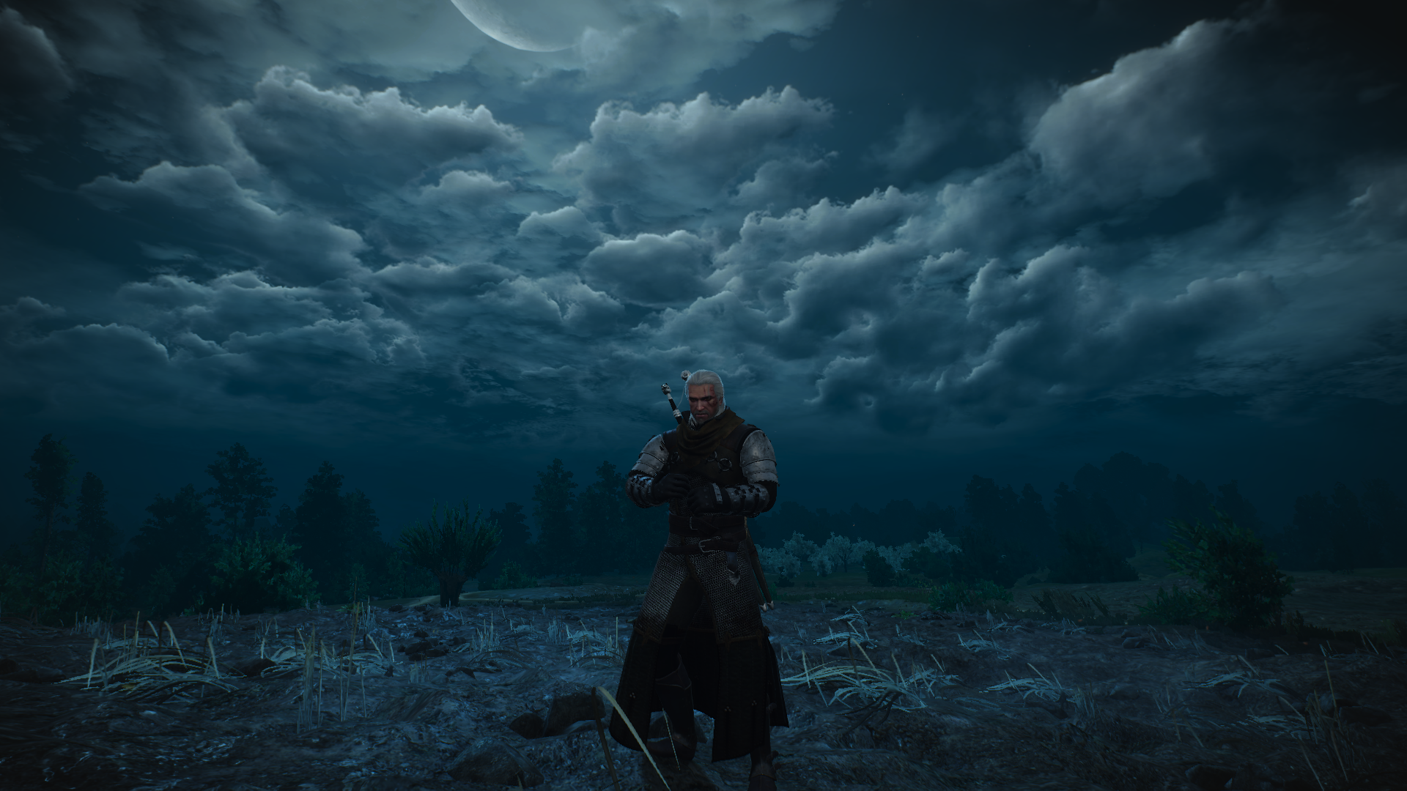
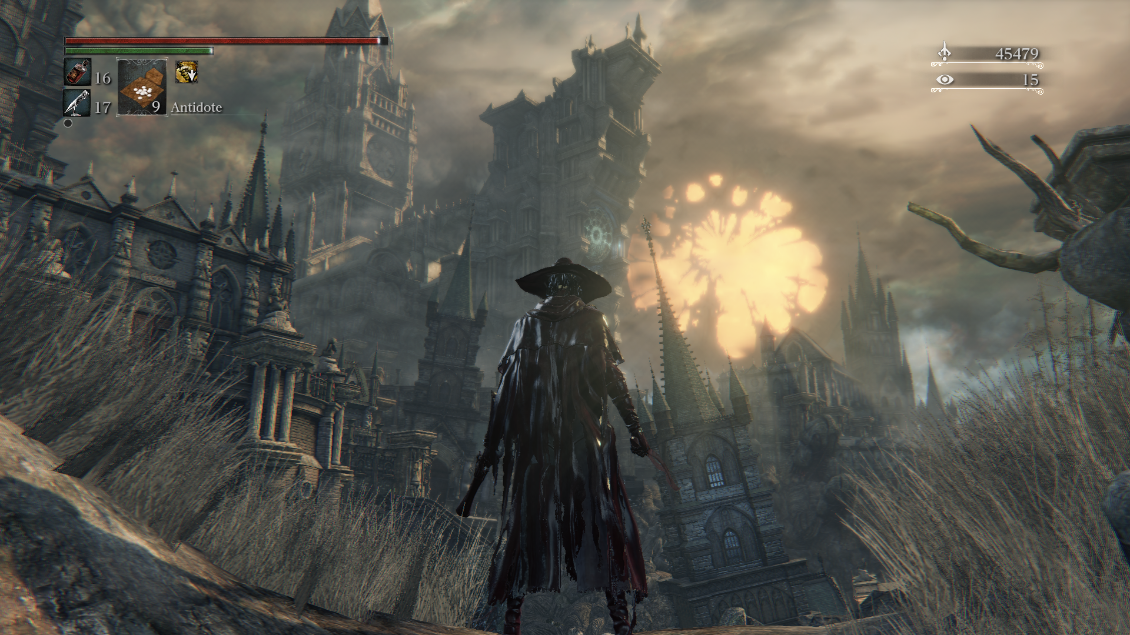
Environment mapping
Image-based technique
Fake environment
Background image / skybox
Cheap reflections
Environment lighting

Slide 3
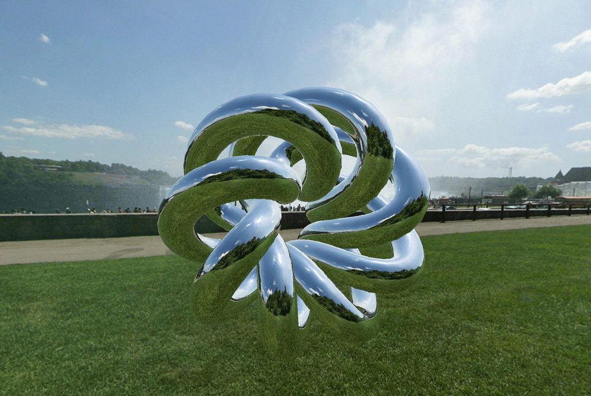
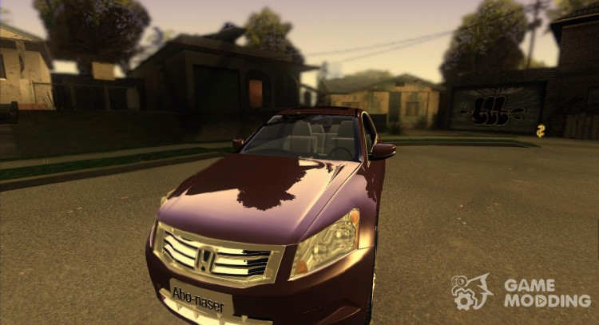
Environment mapping
Image-based technique
Fake environment
Background image / skybox
Cheap reflections
Environment lighting

Slide 4
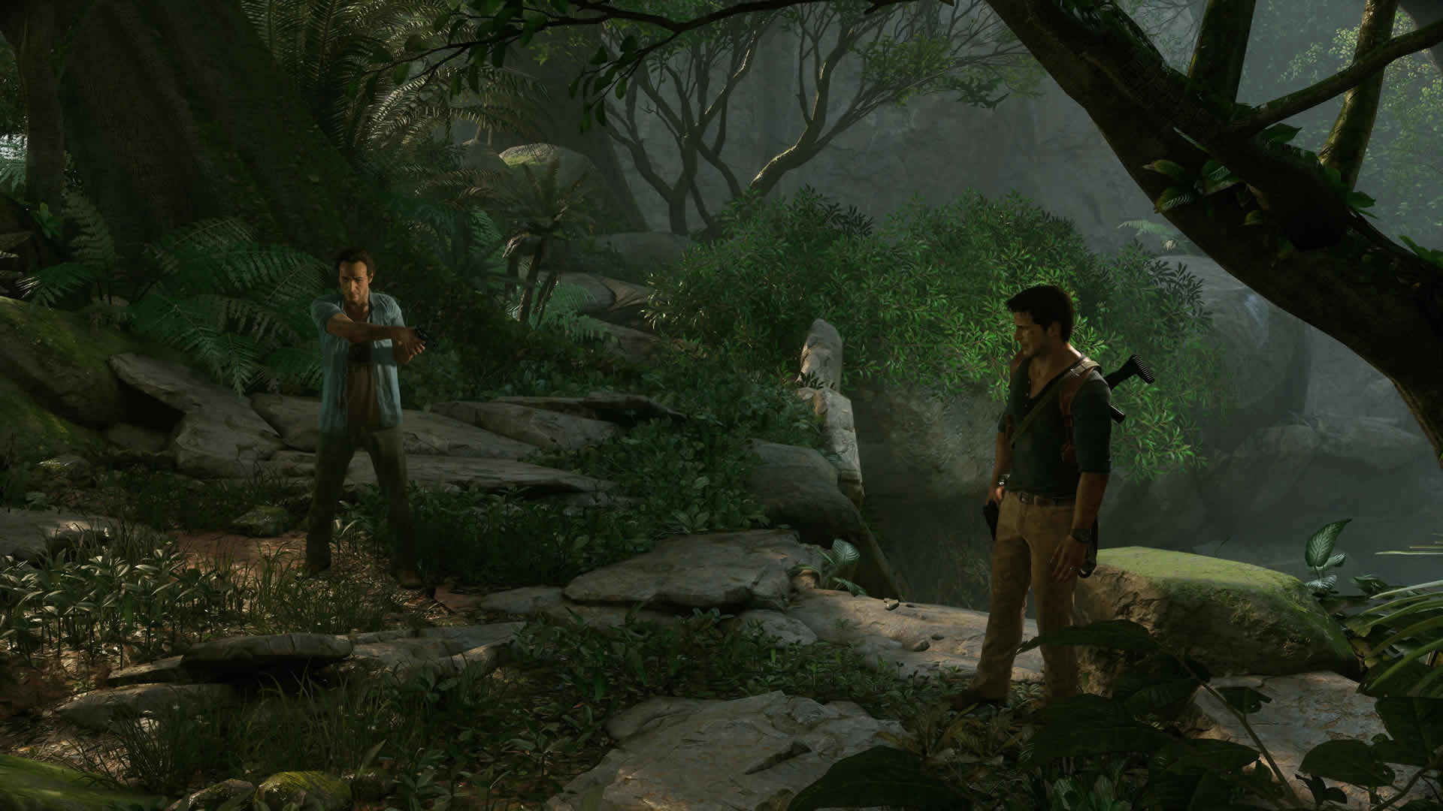
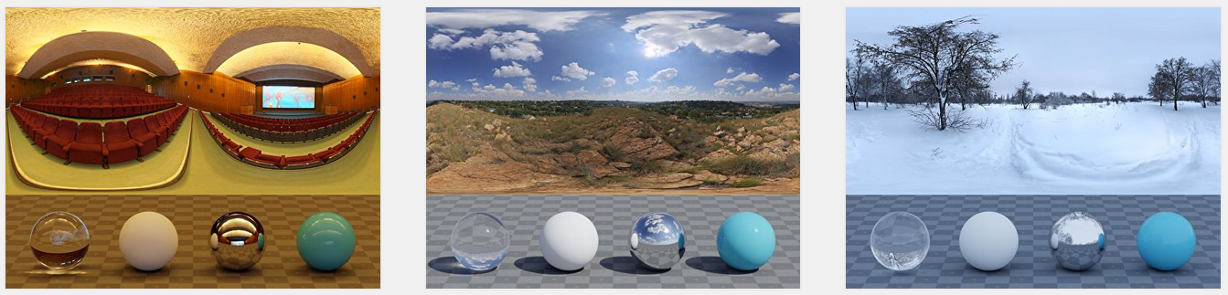
Environment mapping
Image-based technique
Fake environment
Background image / skybox
Cheap reflections
Environment lighting

Slide 5
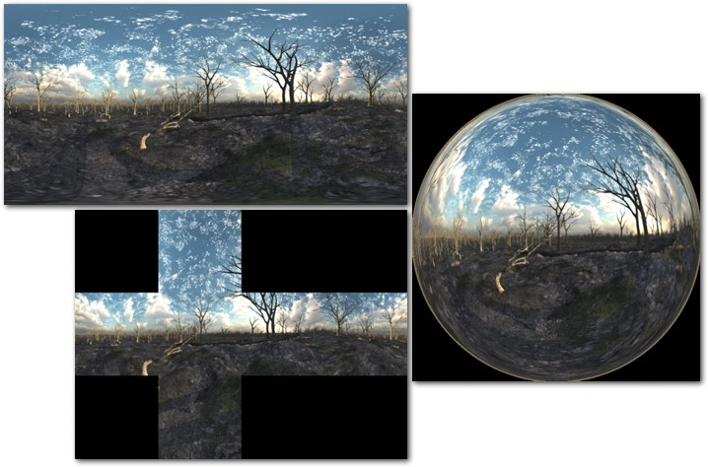
Environment mapping
2 main formats
Cube projection
Equirectangular / spherical projection
Cubic projection
Cubemap texture
2D texture
Equirectangular / spherical projection

Slide 6
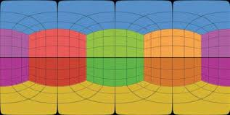
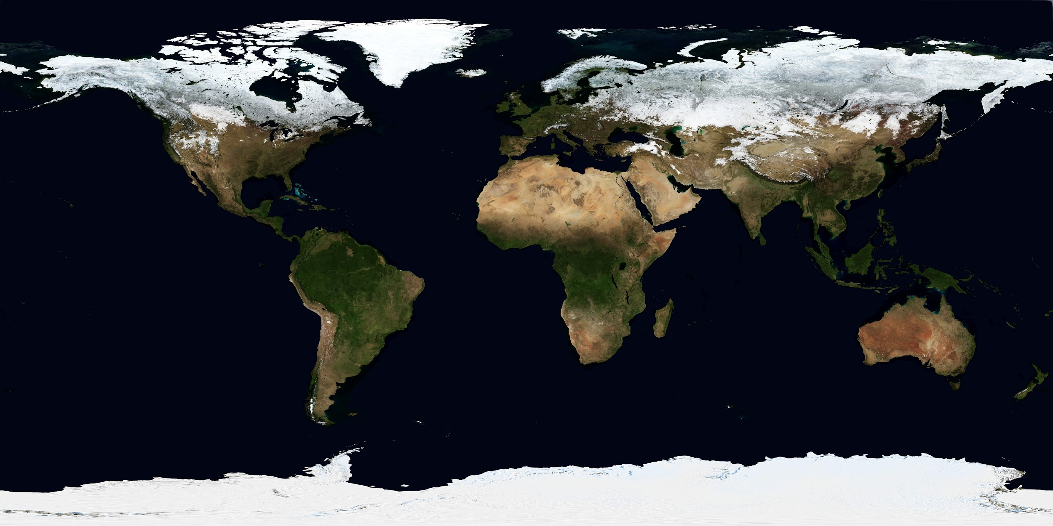
Equirectangular projection
OpenGL 2D texture
Accessed with standard texture coords (u,v)
More distorted as v goes north and south
Texels at v=0 and v=1 correspond to the south and north poles.
Common format to store panoramic images
(u,v)=(1,1)
(u,v)=(0,0)

Slide 7
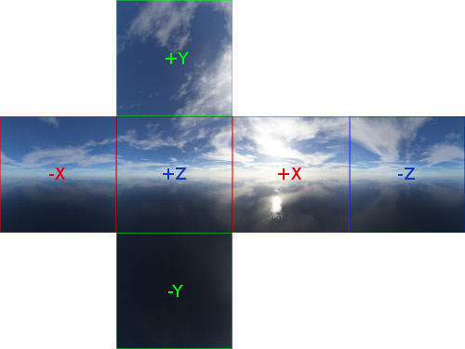
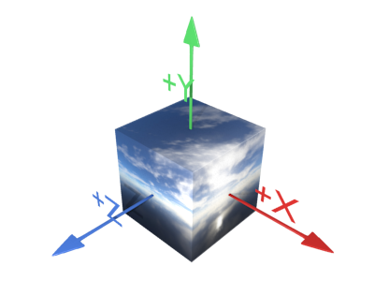
Cubic projection
OpenGL cubemap texture
Accessed with a 3d direction vector (x,y,z)
More distortion towards cube edges and corners
Much less distortion than equirectangular
Format of choice for environment mapping in OpenGL
Load 6 2D images into the cubemap faces
We can also load equirectangular images and bake them into a cubemap
We can render to cubemap texture...

Slide 8
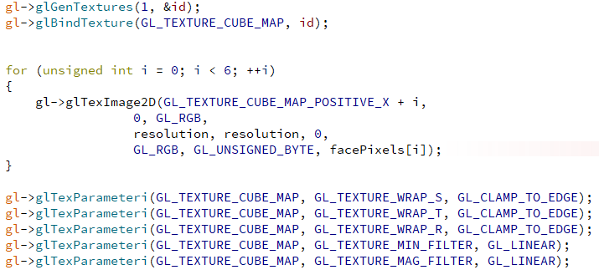
Creating a cubemap in OpenGL
Could be nullptr if it’s intended to be used as a render target
Could be a floating-point cubemap to store an HDR image

Slide 9
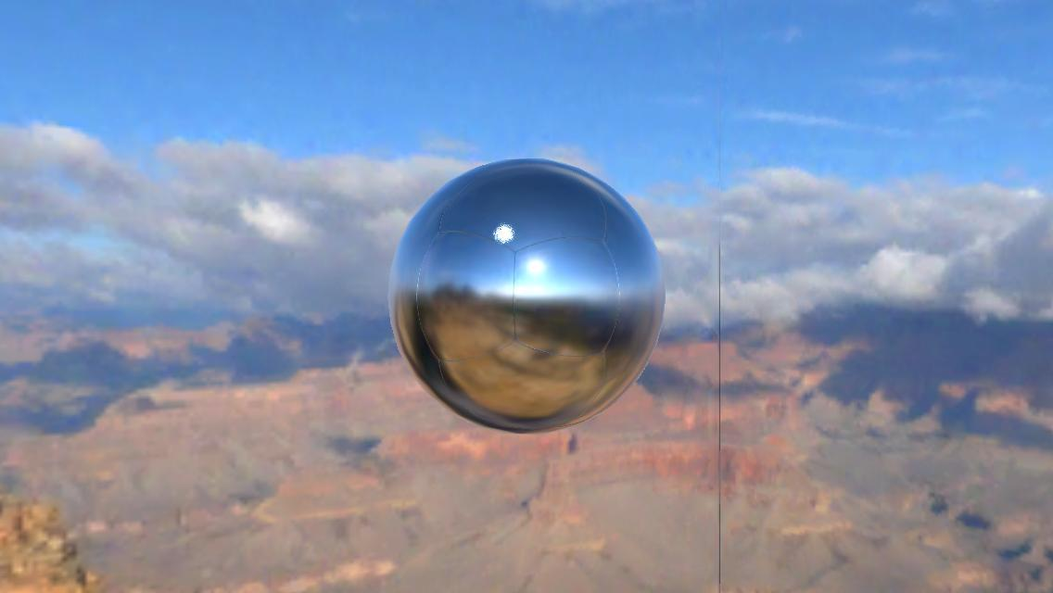
Enable interpolation among cube faces
OpenGL does not interpolate among cube faces by default
Enable interpolation during initializeGL()

Slide 10
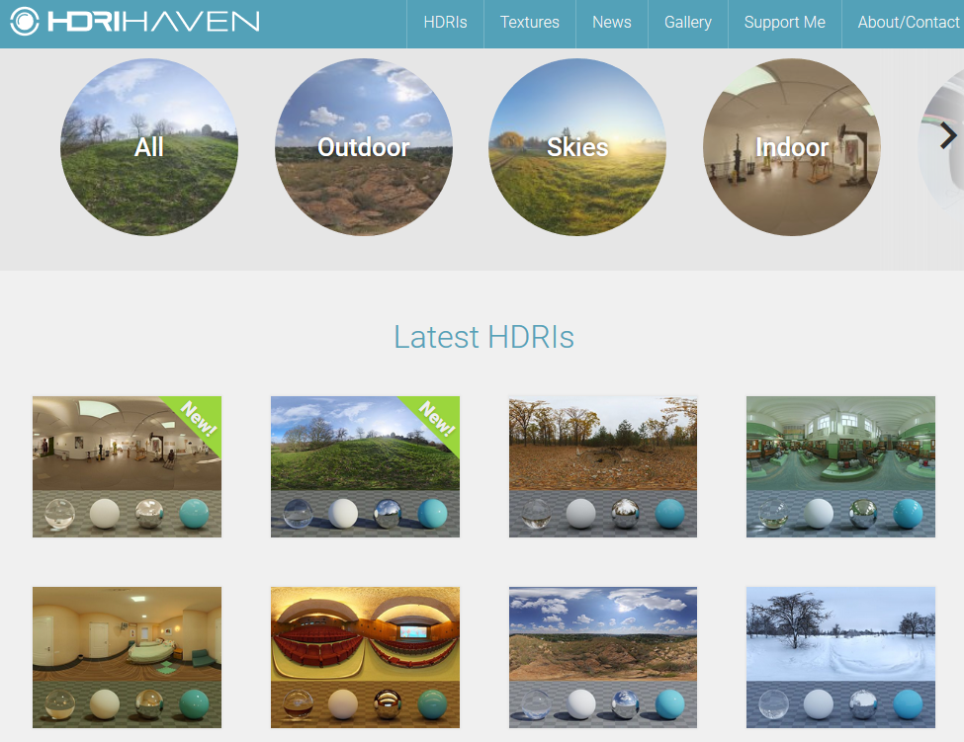
Free HDR images

Slide 11
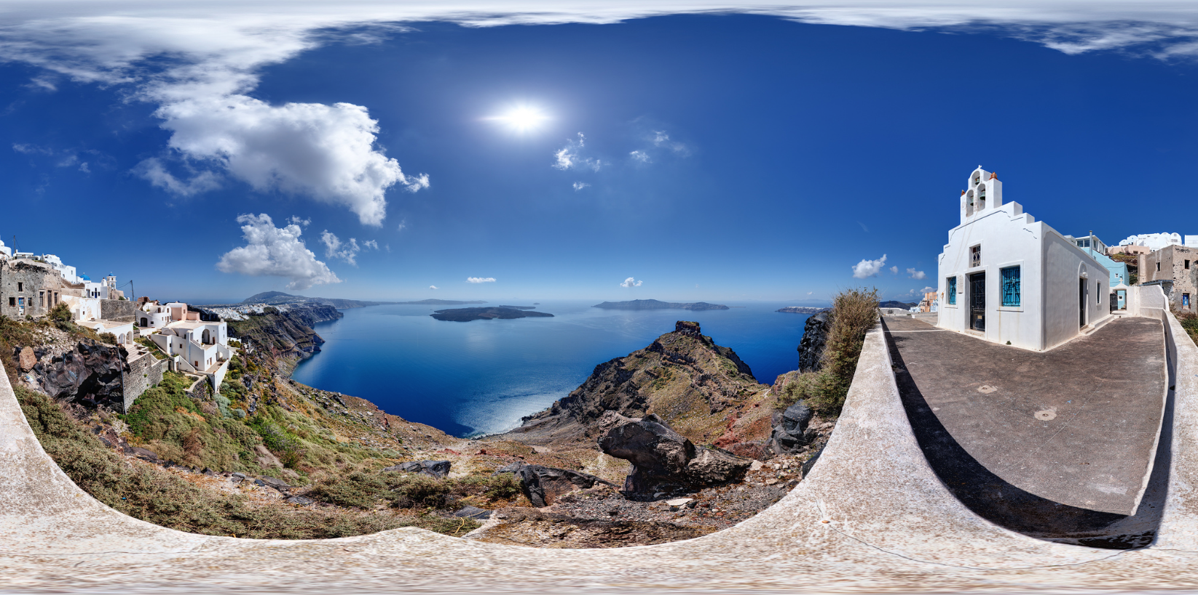
HDRI spherical panorama
Wide view of a scene
Spherical / equirectangular projection
High dynamic range (HDR) values beyond [0, 255].

Slide 12
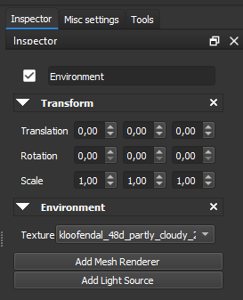
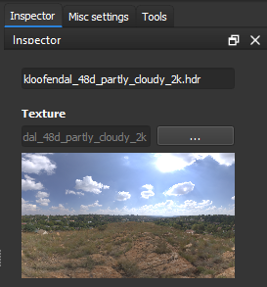
Environment component

Slide 13
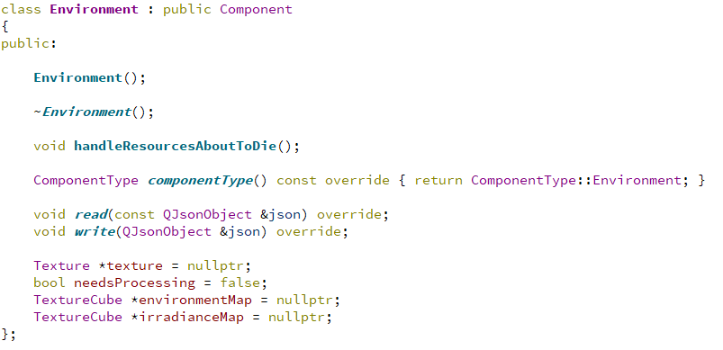
Environment component
2D texture with the hdr image
Cubemap texture (baked from the 2d textured)
???

Slide 14
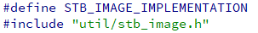
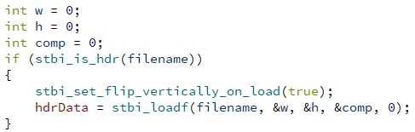
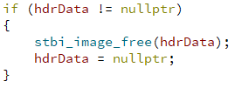
Opening an HDR image (.hdri)
Sean Barrett’s STB library: stb_image.h

Slide 15
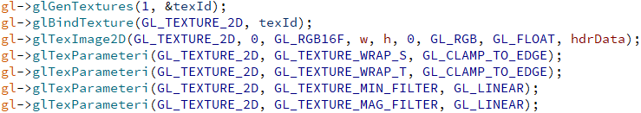
Uploading an HDR image to the GPU
Pay attention to the flags GL_RGB16F and GL_FLOAT
It is a floating-point texture

Slide 16
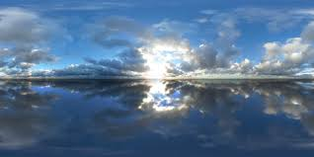
Baking from equirectangular to cubemap
Prefer cubemap textures for real-time algorithms
Import 2D HDR image and bake into cubemap

Slide 17
Baking from equirectangular to cubemap
Create a framebuffer object to attach the cubemap render targets (output)
Bind the HDR equirectangular image (input)
Start using the baking shader
Perform 6 iterations (1 for each face). At each one:
Change camera view direction
Change render target
Use the corresponding cubemap face
glDrawArrays()

Slide 18
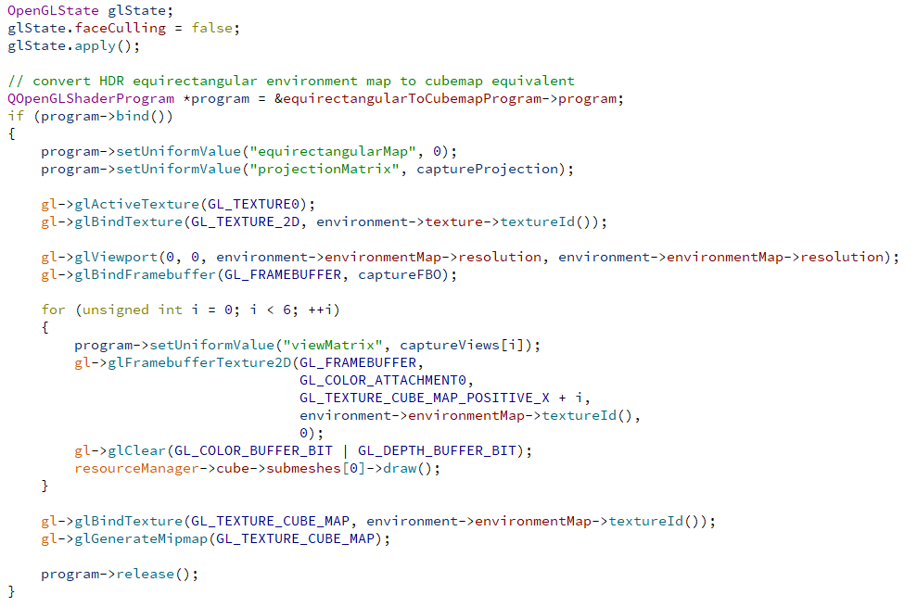
Baking from equirectangular to cubemap
OpenGL code

Slide 19
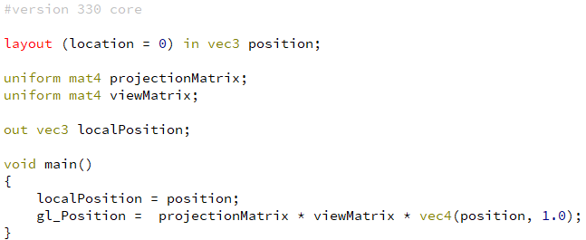
Baking from equirectangular to cubemap
Vertex shader
Will be used as the direction by the fragment shader
Fovy = 90
Aspect ratio = 1 (perfect square)
Will look at a different face at each iteration

Slide 20
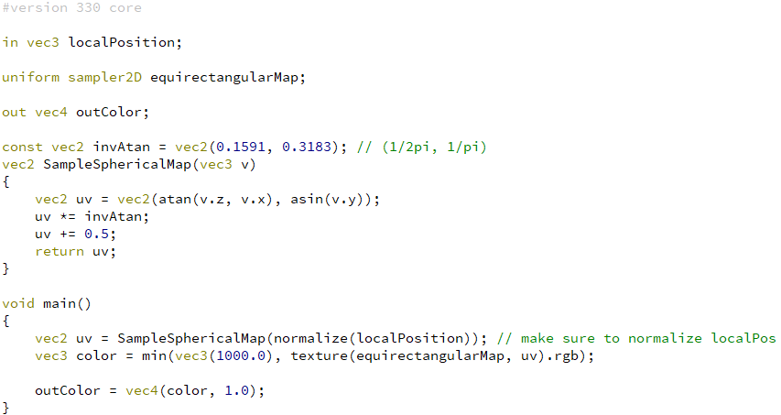
Baking from equirectangular to cubemap
Fragment shader

Slide 21
Three environment mapping techniques with cubemaps
Skybox
Environment reflections
Environment (diffuse) lighting

Slide 22
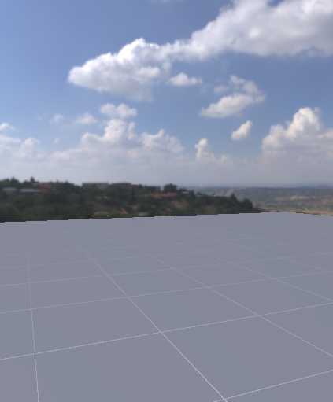
Skybox

Slide 23
Skybox
Viewport

Slide 24
Skybox
Viewport
Clear color and depth buffer
Enable z-testing

Slide 25
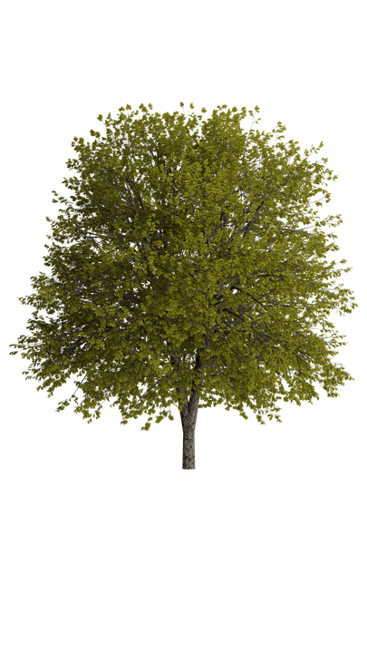
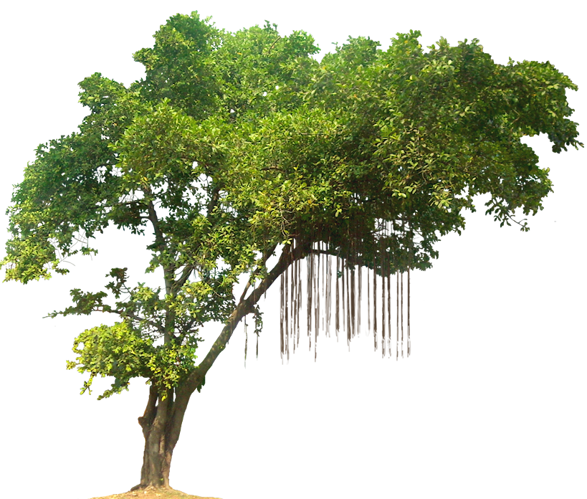
Skybox
Viewport
Clear color and depth buffer
Enable z-testing
Render opaque scene objects

Slide 26
Skybox
Viewport
Clear color and depth buffer
Enable z-testing
Render opaque scene objects

Slide 27
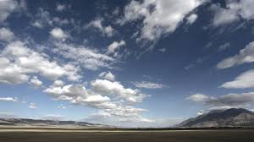
Skybox
skybox
Viewport
Clear color and depth buffer
Enable z-testing
But disable z-write
Render opaque scene objects
Render skybox in the background. Some options:
Big cube. Or...
Divide xyz by z in the vertex shader

Slide 28
Skybox
skybox
Viewport
Clear color and depth buffer
Enable z-testing
But disable z-write
Render opaque scene objects
Render skybox in the background. Some options:
Big cube. Or...
Divide xyz by z in the vertex shader
The fragment shader takes the color from the cube map texture using the cube position as texture coordinates.

Slide 29
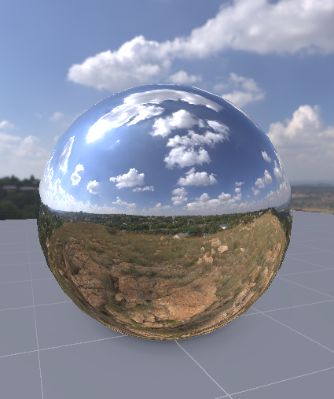
Environment specular reflection

Slide 30
Environment specular reflection
In the same shader where we illuminate fragments
N
Light ray

Slide 31
Environment specular reflection
In the same shader where we illuminate fragments
N
Light ray

Slide 32
Environment specular reflection
In the same shader where we illuminate fragments
N
Light ray

Slide 33
Environment specular reflection
In the same shader where we illuminate fragments
Viewing ray (-V)
N
Reflected ray

Slide 34
Environment specular reflection

Slide 35
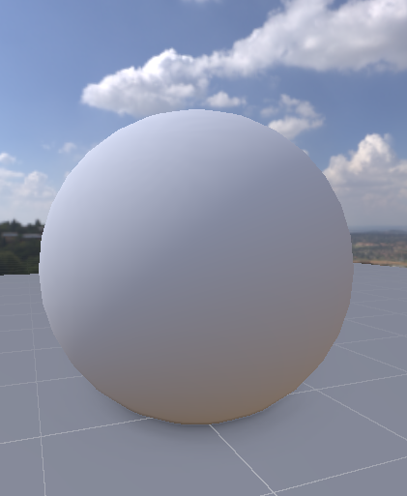
Environment diffuse reflection

Slide 36
Environment diffuse reflection
Light comes from all directions...
Viewing ray (V)
N
Summation of all incoming light:
Albedo * Li color * dot(Li, N)

Slide 37
Environment diffuse reflection
Light comes from all directions…
And scatters in all directions
Viewing ray (V)
N
Summation of all incoming light:
Albedo * Li color * dot(Li, N)

Slide 38
Environment diffuse reflection
Light comes from all directions…
And scatters in all directions
Viewing ray (V)
N
Summation of all incoming light:
Albedo * Li color * dot(Li, N)
“infinite” texture lookups?
Not feasible in real-time

Slide 39
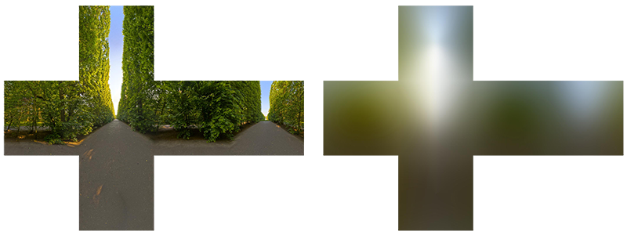
Environment diffuse reflection
We can precompute a cubemap with the summation of light irradiances from many directions, for each texel in the cubemap.
The resolution of the irradiance map can be much lower (e.g. 32^2 each face)
Original environment map
Precomputed irradiance map

Slide 40
Environment diffuse reflection
Algorithm
Create a new cubemap texture for the output irradiance map
Use the convolution shader
Bind the environment cubemap and send it to the shader
For each face of the output irradiance map
Attach the corresponding irradiance cubemap face as a color render target
Set the current camera parameters into the shader
Send the geometry of a cube to render

Slide 41
Environment diffuse reflection

Slide 42
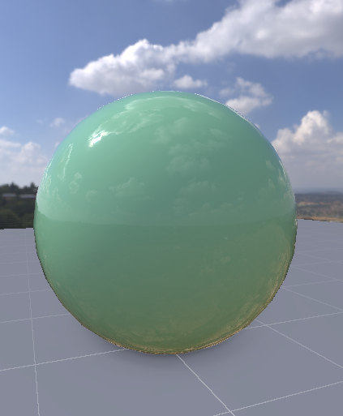
Combined diffuse and specular reflections

Slide 43

Combined diffuse and specular reflections

Slide 44
Resources
HDRI environment map archives:
https://hdrihaven.com/
http://hdrlib.com/
To bake equirectangular projected images onto cubemaps:
https://learnopengl.com/PBR/IBL/Diffuse-irradiance
Cubemap tutorials (skybox, reflection):
https://learnopengl.com/Advanced-OpenGL/Cubemaps
http://antongerdelan.net/opengl/cubemaps.html

Slide 45

Questions?

